Slide 1
CNN: Convolutional Neural Nets
Computer Vision

Slide 2
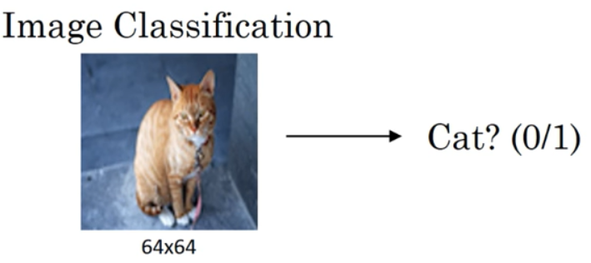
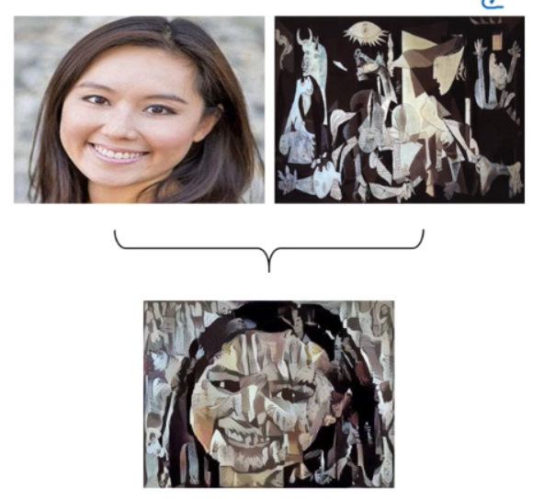
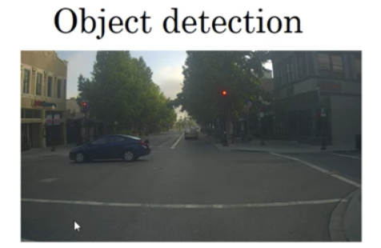
Computer Vision Problems
Neural Style Transfer
object img
style img
Draw boxes
around objects

Slide 3

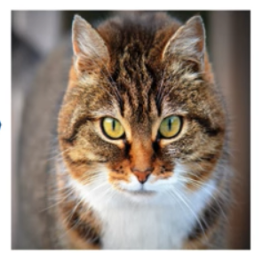
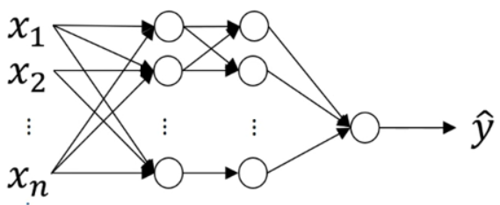





Deep learning on large images
$$64×64×3=1288 \text{px}$$
Infeasable with standard Deep-FNN
$$Θ^{[1]}:(1000,3\text{M}\text{)}$$
$$1000×1000×3=3\text{M} \text{px}$$
$$3\text{M}$$
$$1000$$

Slide 4
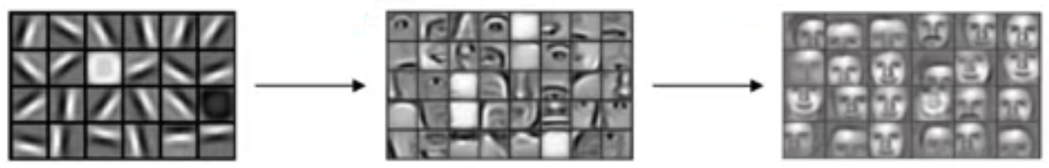
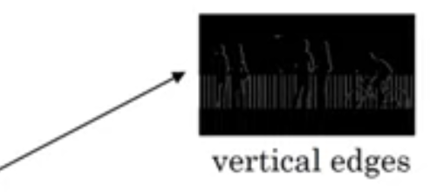
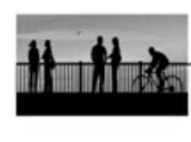
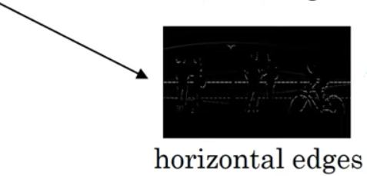
Focusing on edge detection

Slide 5
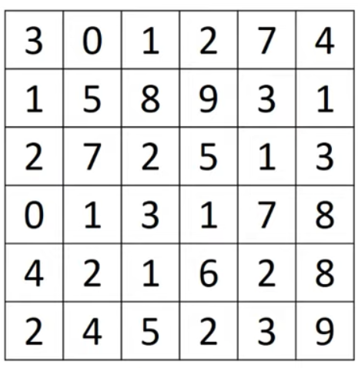
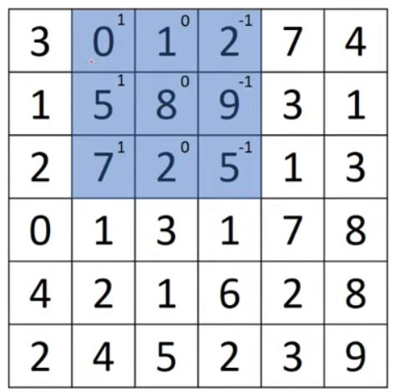
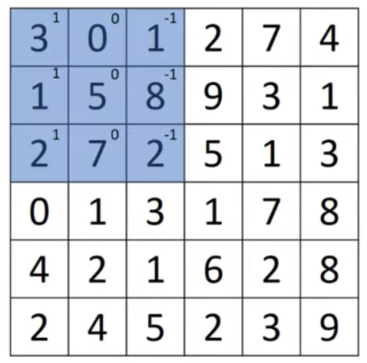
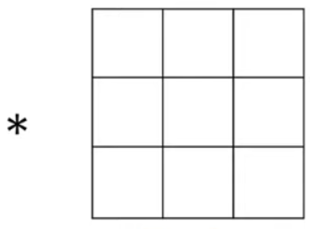
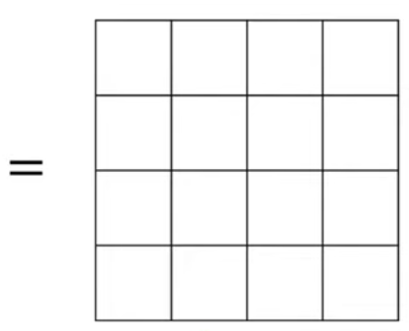










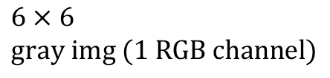


Convolution
$$3×1+0×0+1×−1+1×1+5×0+8×−1+2×1+7×0+2×−1=−5$$
$$0×1+1×0+2×−1+5×1+8×0+9×−1+7×1+2×0+5×−1=−4$$
convolution
$$1$$
$$0$$
$$−1$$
$$−5$$
$$−4$$
$$1$$
$$0$$
$$−1$$
$$1$$
$$0$$
$$−1$$
$$3×3 \\ \text{filter} \text{or} \text{kernel}$$
$$6×6 \\ \text{gray} \text{img}\text{ (1 }\text{RGB} \text{channel}\text{)}$$

Slide 6
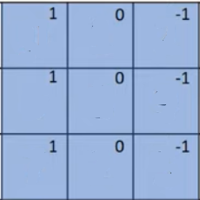












Convolution
$$1$$
$$2$$
$$7$$
$$8$$
$$9$$
$$3$$
$$1$$
$$0$$
$$−1$$
$$−5$$
$$−4$$
$$0$$
$$2$$
$$5$$
$$1$$
$$1$$
$$0$$
$$−1$$
$$1$$
$$0$$
$$−1$$
$$3×3 \\ \text{filter} \text{or} \text{kernel}$$
$$6×6 \\ \text{gray} \text{img}\text{ (1 }\text{RGB} \text{channel}\text{)}$$

Slide 7









Convolution
$$2$$
$$7$$
$$4$$
$$9$$
$$3$$
$$1$$
$$1$$
$$0$$
$$−1$$
$$−5$$
$$−4$$
$$0$$
8
$$5$$
$$1$$
$$3$$
$$1$$
$$0$$
$$−1$$
$$1$$
$$0$$
$$−1$$
$$3×3 \\ \text{filter} \text{or} \text{kernel}$$
$$6×6 \\ \text{gray} \text{img}\text{ (1 }\text{RGB} \text{channel}\text{)}$$

Slide 8










Convolution
$$1$$
$$5$$
$$8$$
$$1$$
$$0$$
$$−1$$
$$−5$$
$$−4$$
$$0$$
8
$$2$$
$$7$$
$$2$$
$$−10$$
$$1$$
$$0$$
$$−1$$
$$0$$
$$1$$
$$3$$
$$1$$
$$0$$
$$−1$$
$$3×3 \\ \text{filter} \text{or} \text{kernel}$$
$$6×6 \\ \text{gray} \text{img}\text{ (1 }\text{RGB} \text{channel}\text{)}$$

Slide 9









Convolution
$$5$$
$$8$$
$$9$$
$$1$$
$$0$$
$$−1$$
$$−5$$
$$−4$$
$$0$$
8
$$7$$
$$2$$
$$5$$
$$−10$$
$$−2$$
$$1$$
$$0$$
$$−1$$
$$1$$
3
$$1$$
$$1$$
$$0$$
$$−1$$
$$3×3 \\ \text{filter} \text{or} \text{kernel}$$
$$6×6 \\ \text{gray} \text{img}\text{ (1 }\text{RGB} \text{channel}\text{)}$$

Slide 10


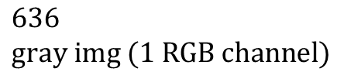





Convolution
$$8$$
9
$$3$$
$$1$$
$$0$$
$$−1$$
$$−5$$
$$−4$$
$$0$$
8
$$2$$
$$5$$
$$1$$
$$−10$$
$$−2$$
2
$$1$$
$$0$$
$$−1$$
$$3$$
1
$$7$$
$$1$$
$$0$$
$$−1$$
$$3×3 \\ \text{filter} \text{or} \text{kernel}$$
$$636 \\ \text{gray} \text{img}\text{ (1 }\text{RGB} \text{channel}\text{)}$$

Slide 11







Convolution
$$`9$$
3
$$1$$
$$1$$
$$0$$
$$−1$$
$$−5$$
$$−4$$
$$0$$
8
$$5$$
$$1$$
$$3$$
$$−10$$
$$−2$$
2
3
$$1$$
$$0$$
$$−1$$
$$1$$
7
$$8$$
$$1$$
$$0$$
$$−1$$
$$3×3 \\ \text{filter} \text{or} \text{kernel}$$
$$636 \\ \text{gray} \text{img}\text{ (1 }\text{RGB} \text{channel}\text{)}$$

Slide 12








Convolution
$$1$$
$$0$$
$$−1$$
$$−5$$
$$−4$$
$$0$$
8
$$2$$
7
$$2$$
$$−10$$
$$−2$$
2
3
$$1$$
$$0$$
$$−1$$
$$0$$
$$1$$
$$3$$
$$0$$
$$1$$
$$0$$
$$−1$$
$$4$$
2
$$1$$
$$3×3 \\ \text{filter} \text{or} \text{kernel}$$
$$636 \\ \text{gray} \text{img}\text{ (1 }\text{RGB} \text{channel}\text{)}$$
ETC….

Slide 13














Convolution
$$1$$
$$0$$
$$−1$$
$$−5$$
$$−4$$
$$0$$
8
$$−10$$
$$−2$$
2
3
$$1$$
$$0$$
$$−1$$
$$1$$
7
$$8$$
$$0$$
$$−2$$
$$−4$$
$$−7$$
$$1$$
$$0$$
$$−1$$
$−$16
$$−3$$
$$−2$$
$$−3$$
$$6$$
$$2$$
$$8$$
$$3×3 \\ \text{filter} \text{or} \text{kernel}$$
$$2$$
3
$$9$$
$$636 \\ \text{gray} \text{img}\text{ (1 }\text{RGB} \text{channel}\text{)}$$

Slide 14
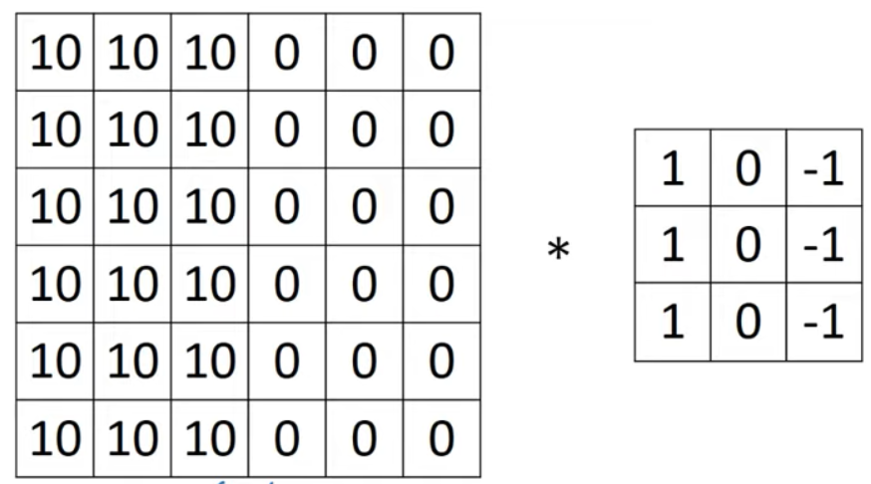
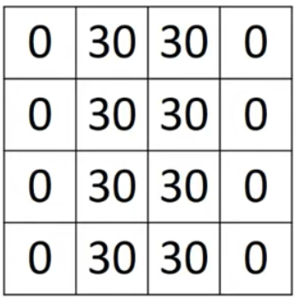

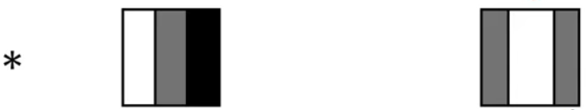


Vertical edge detection
light px on the left
dark px on the right
$$=$$
Thick edge because small img
$$=$$

Slide 15
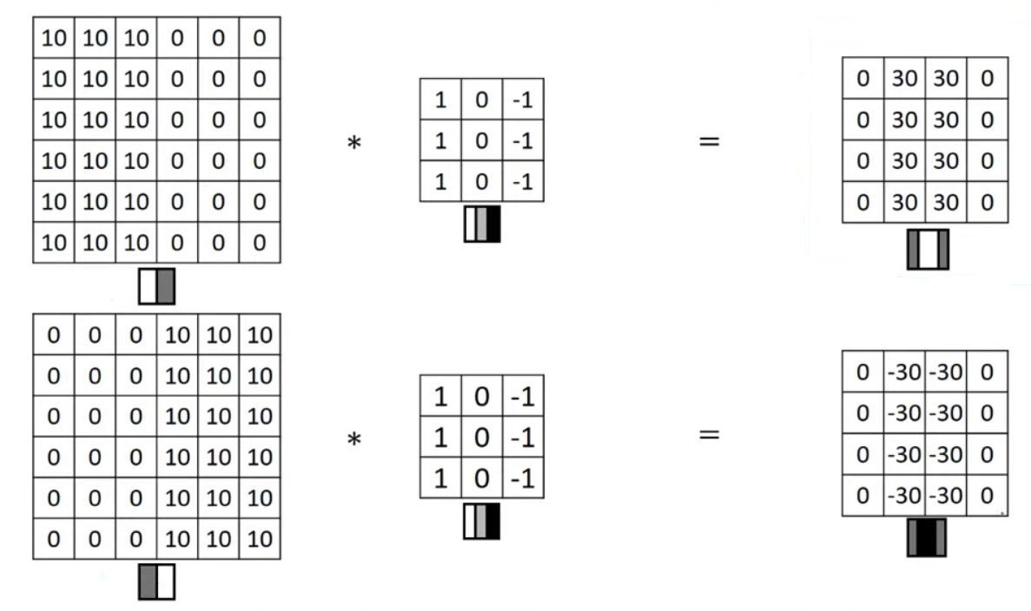
light edge
dark edge

Slide 16
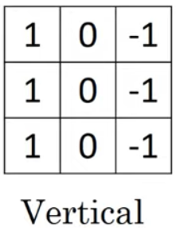
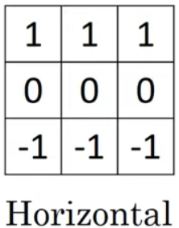
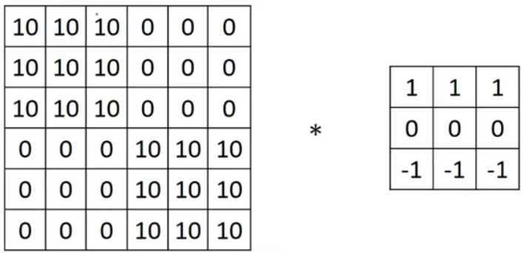
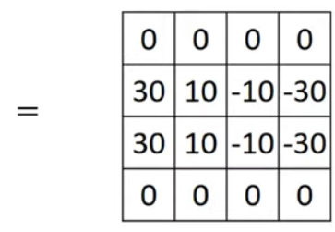
part of both kind of hor. edges
bright above
dark below
bright below
dark above

Slide 17
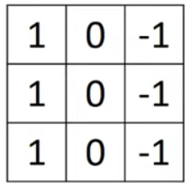
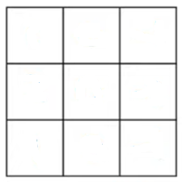
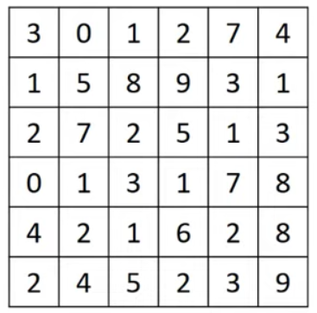
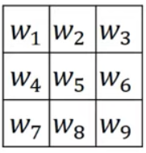

Learning to detect edges
1
0
-1
3
0
-3
2
0
-2
10
0
-10
1
0
-1
3
0
-3
Standard filter
Sobel filter
Scharr filter
What about learning the filter parameters instead of hand-crafting them?
$$∗$$
Treat them as learnable parameters
and learn through back-prop

Slide 18





Original img
Filter
Modified img
$$f×f$$
$$(n−f+1)×(n−f+1)$$
$$n×n$$
Two main downsizes:
Every time a filter is applied the image shrink
Pixels on the corners/edges of the image are less involved in the output (the filter is applied more to central pixels)
$$⇒ \text{PADDING}$$

Slide 19
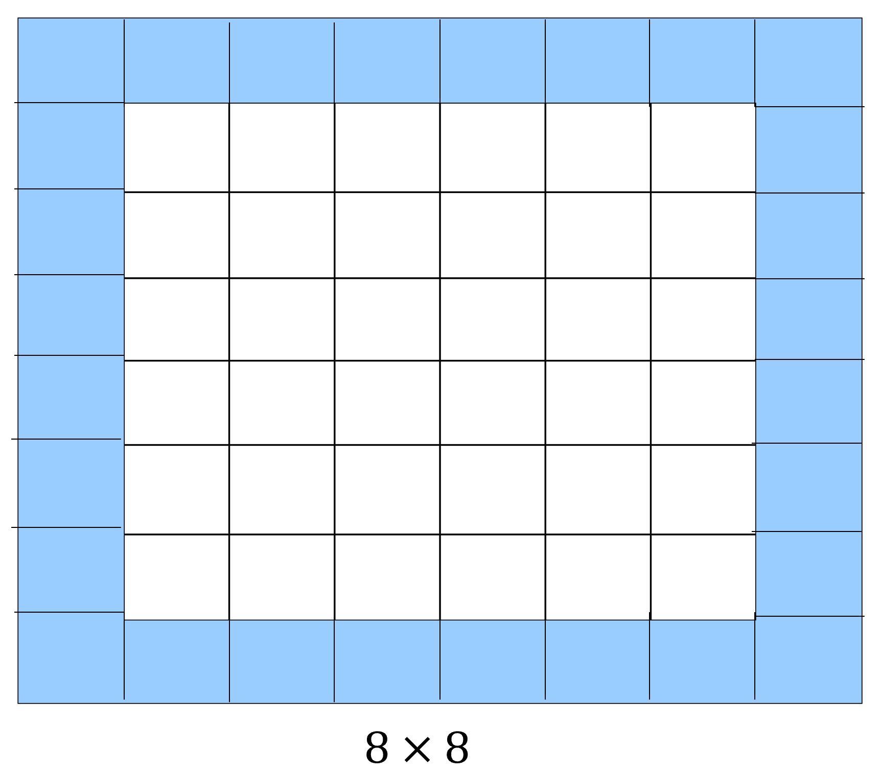





















Padding
$$p=\text{padding} \text{size}$$
$$0 0 0 0 0 0 0 0$$
$$0$$
$$0$$
$$0$$
$$0$$
$$0$$
$$0$$
$$=$$
$$0$$
$$0$$
$$0$$
$$0$$
$$0$$
$$0$$
$$f×f$$
$$0 0 0 0 0 0 0 0$$
$$\left(n+2p−f+1\right)×\left(n+2p−f+1\right)$$
$$6×6$$
3$×3$
$$p=1$$
$$6×6$$
$$(n+2p)×(n+2p)$$

Slide 20
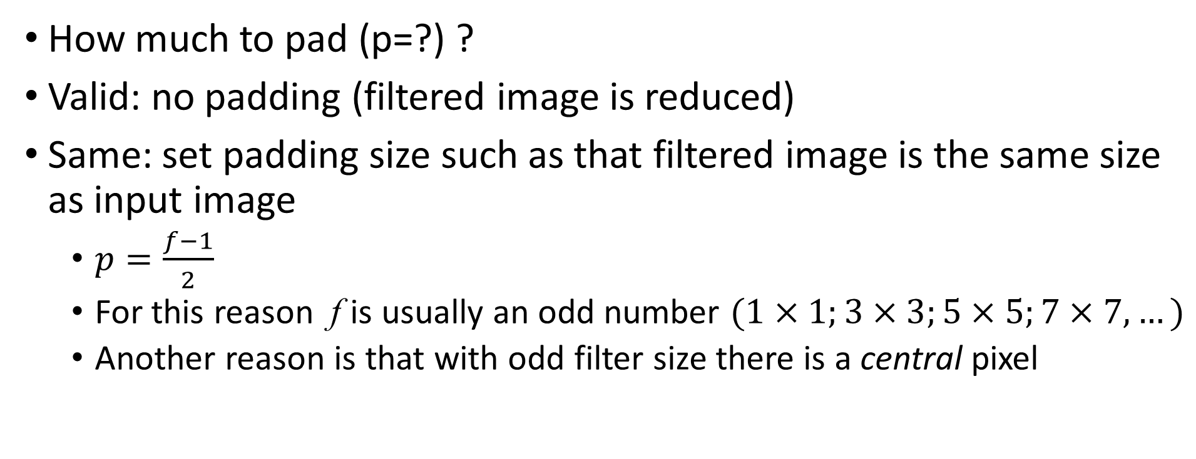
Valid and Same Convolution
How much to pad (p=?) ?
Valid: no padding (filtered image is reduced)
Same: set padding size such as that filtered image is the same size as input image
  $p=\frac{f−1}{2}$
  For this reason f is usually an odd number $(1×1;3×3;5×5;7×7, …)$
  Another reason is that with odd filter size there is a central pixel

Slide 21
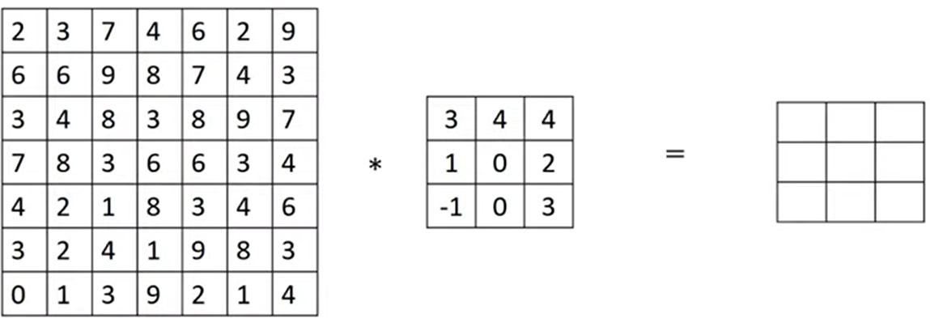
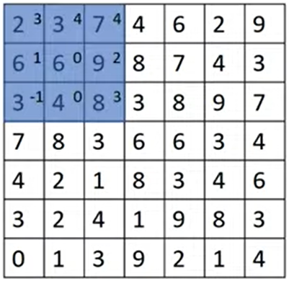
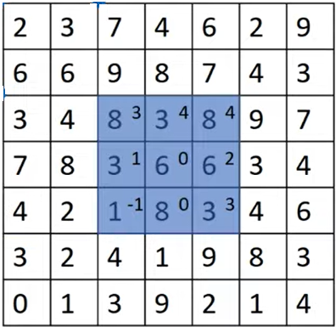
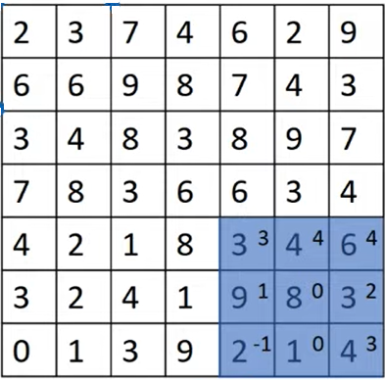
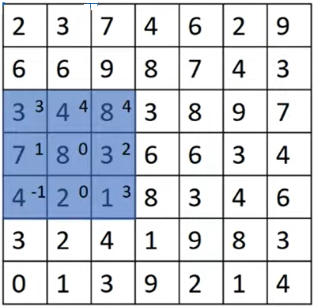
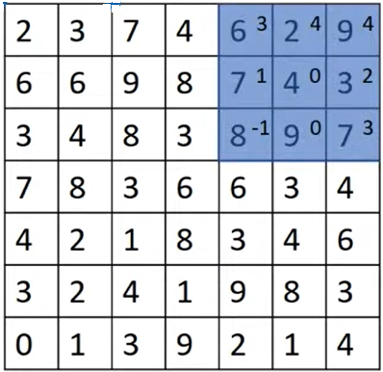
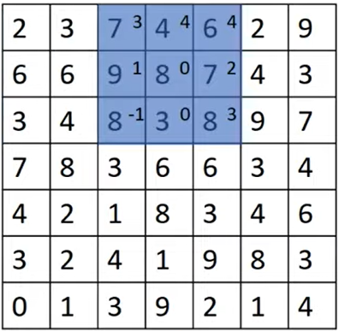










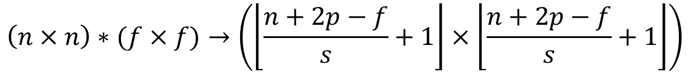

Strided convolution
shift the filter of s steps (s>1)
$$s=2$$
$$91$$
$$100$$
$$83$$
$$69$$
$$91$$
$$127$$
$$44$$
$$72$$
$$74$$
$$\left(n×n\right)∗(f×f)→\left(\left\lfloor \frac{n+2p−f}{s}+1\right\rfloor ×\left\lfloor \frac{n+2p−f}{s}+1\right\rfloor \right)$$
$$\text{padding}\text{=}p \text{stride}\text{=}s$$

Slide 22
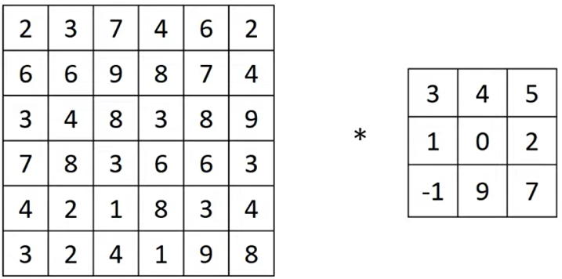
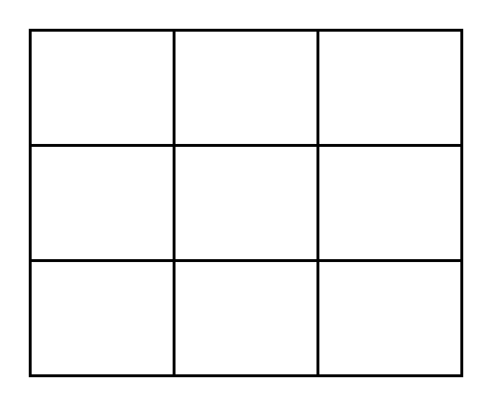






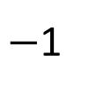


Cross-correlation vs convolution
Technically we have described an operation
that in signal processing is called cross-correlation
To get what they call convolution, the filter
must be previously flipped both horizontally
and vertically
This allows convolution to satisfy associative property
In deep learning we do not bother about flipping!
$$7$$
$$2$$
5
$$∗$$
$$9$$
$$0$$
$$4$$
$−$1
$$1$$
$$3$$

Slide 23






Convolution on RGB Images
$$∗$$
$$=$$
$$3×3×3$$
$$4×4×1$$
$$6×6×3$$
height
Must be equal
width
channels/depth

Slide 24
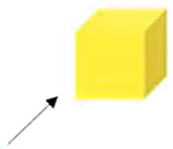
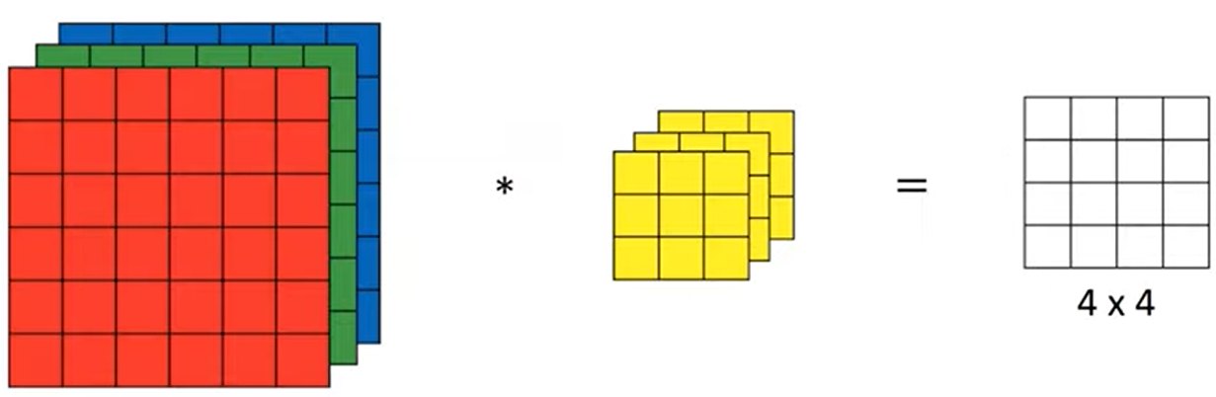
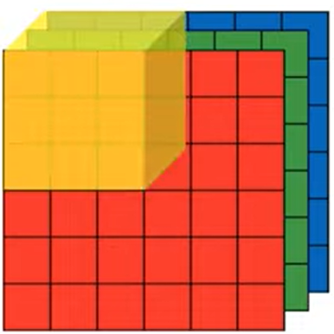
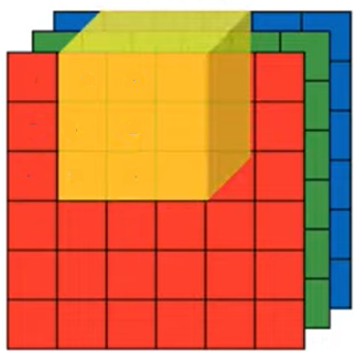
* on channel R + * on channel G + * on channel B
You perform convolution on each channel separately, and them sum-up

Slide 25
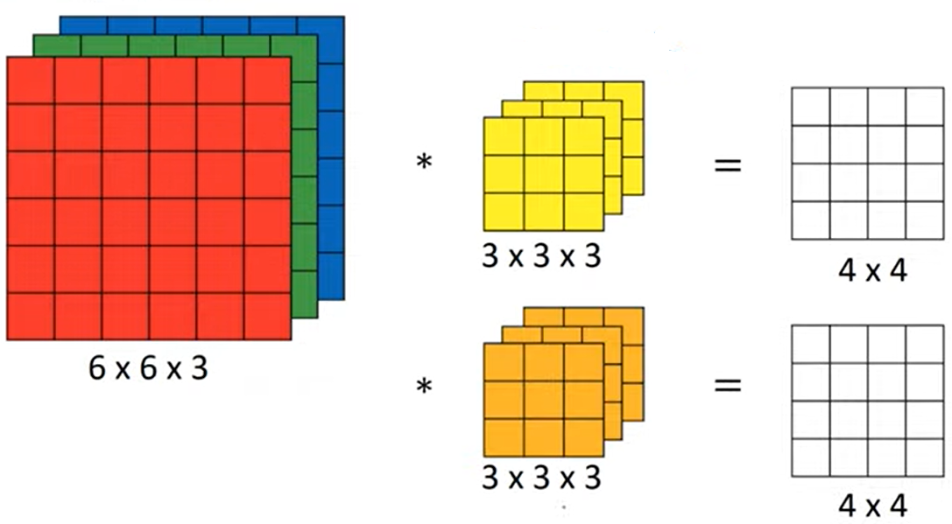


Multiple filters
e.g., vertical edge detector
$$4×4×2$$
#filters
e.g., horizontal edge detector

Slide 26
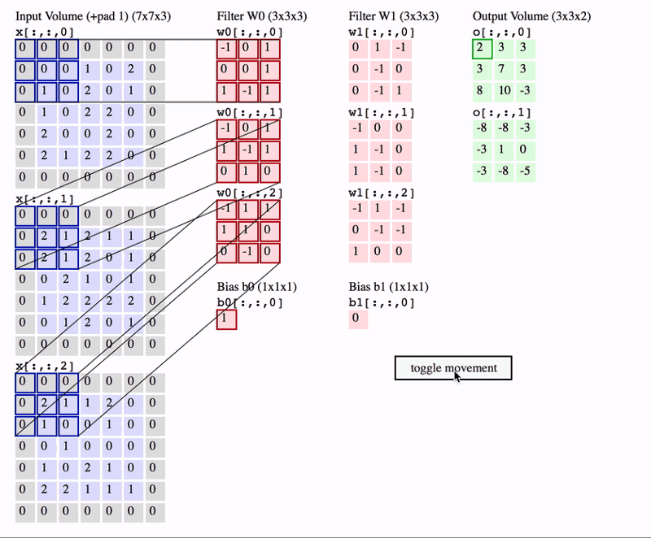

Slide 27
One-layer CNN

Slide 28
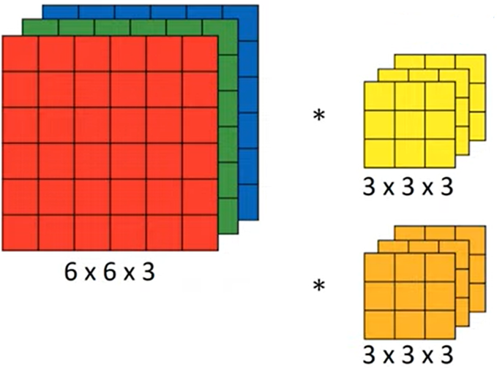
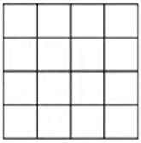



CNN Layer
$$\text{ReLU}\text{( +}b_{1})$$
$$\text{ReLU}\text{( +}b_{2})$$
$$4×4×2$$

Slide 29













$$\text{ReLU}\text{( +}b_{1})$$
$$\text{ReLU}\text{( +}b_{2})$$
$$a^{[i−1]}$$
$$g$$
$$z^{[i]}$$
$$Θ^{[i]}$$
One layer CNN
$$4×4×2$$
$$3×3$$
$${g(z}^{[i]})=a^{[i]}$$
$$z^{[i]}=Θ^{[i]}a^{[i−1]}$$
$$a^{[i]}={g(z}^{[i]})$$
$$6×6×3 a^{[i−1]}$$
$$4×4×2 a^{[i]}$$

Slide 30

Remark
If you have k filters of dimensions $f_{h}×f_{w}×c$ in a CNN layer, then you need to learn $f_{h}×f_{w}×c×k$ parameters
The number of parameters does not depend on the input of the layer (in other words on the input image)
Once you have learnt k feature detectors that works well, then you can apply them to images of any size
This is one characteristic of CNN that make them less prone to overfitting (the “fixed”number of parameters to learn)

Slide 31







Summary of notation
If layer $l$ is a convolutional layer
  $$f^{[l]}=\text{filter} \text{size}$$
  $$p^{[l]}=\text{padding}$$
  $s^{[l]}=\text{stride}$
  $n_{H}^{[l]}=\text{height}$
  $n_{W}^{[l]}=\text{width}$
  $n_{c}^{[l]}=\text{number} \text{of} \text{channels}\text{/}\text{filters}$
$$\text{Input}\text{: }n_{H}^{[l−1]}×n_{W}^{[l−1]}×n_{c}^{[l−1]}$$
$$\text{O}\text{utput}\text{: }n_{H}^{[l]}×n_{W}^{[l]}×n_{c}^{[l]}$$
$$n_{H}^{[l]}=\left\lfloor \frac{n_{H}^{[l−1]}+2p^{[l]}−f^{[l]}}{s^{[l]}}+1\right\rfloor$$
$$n_{W}^{[l]}=\left\lfloor \frac{n_{W}^{[l−1]}+2p^{[l]}−f^{[l]}}{s^{[l]}}+1\right\rfloor$$
$$\text{Each} \text{filter} \text{is} f^{[l]}×f^{[l]}×n_{c}^{[l−1]}$$
$$\text{Number} \text{of} \text{Weights}\text{:}{ f}^{[l]}×f^{[l]}×n_{c}^{[l−1]}×n_{c}^{[l]}$$
$$\text{number} \text{of} \text{biases}\text{: }n_{c}^{[l]}$$

Slide 32

Why convolution
The output is only connected to 9 inputs (out of 36)
Parameter Sharing: a feature detectors (e.g., a vertical edge detector) can be used in different parts of the image
Sparsity of connection: in each layer, each output value only depends on a limited number of inputs (few parameters to learn, less prone to overfitting)
Translation invariance: a slight shift in the pixels of a picture does not influence the result

Slide 33
An example ConvNet
Putting things together

Slide 34





























Input
Image
$$10 (3×3) \text{filters}$$
$$20 (5×5) \text{filters}$$
$$40 (5×5) \text{filters}$$
$$39×39×3$$
$$37×37×10$$
$$f^{[0]}=3$$
$f^{[1]}=$5
$$17×17×20$$
$f^{[2]}=$5
$$7×7×40$$
$$p^{[0]}=0$$
$$p^{[1]}=0$$
$$p^{[2]}=0$$
$$s^{[0]}=1$$
$$s^{[1]}=2$$
$$s^{[2]}=2$$
$$n_{H}^{[0]}=39$$
$$n_{H}^{[1]}=37$$
$$n_{H}^{[2]}=17$$
$$n_{H}^{[3]}=7$$
$$n_{W}^{[0]}=39$$
$$n_{W}^{[1]}=37$$
$$n_{W}^{[2]}=17$$
$$n_{W}^{[3]}=7$$
$$n_{c}^{[0]}=3$$
$$n_{c}^{[1]}=10$$
$$n_{c}^{[2]}=20$$
$$n_{c}^{[3]}=40$$
Hyperparameters: padding, stride, #filters, filter size
flatten
softmax
Usually going deeper increases #filters and decreases
height and width
$$7×7×40=1960$$

Slide 35
Types of Layers in ConvNet
Convolutional (CONV)
Pooling (POOL)
Fully Connected / Dense (FC)

Slide 36















Pooling: Max pooling
Hyperparameters:
filter size $f=2$
stride $s=2$
$$max⁡(1,3,2,9)$$
$$max⁡(2,1,1,1)$$
$$9$$
$$2$$
$$6$$
$$3$$
$$2×2$$
$$max⁡(2,3,1,2)$$
$$max⁡(1,3,5,6)$$
$$4×4$$
Intuition: the largest value works as the feature
detector in a given region

Slide 37






















Output size: $\left\lfloor \frac{n+2p−f}{s}+1\right\rfloor$
$$9$$
$$9$$
$$5$$
$$9$$
$$9$$
$$5$$
$$8$$
$$6$$
$$9$$
$$3×3$$
$$5×5$$
If we have more channels, same computation on each one
$$f=3$$
$$s=1$$

Slide 38






Pooling: Average pooling
$$3.75$$
$$1.25$$
$$4$$
$$2$$
As before , but you take the average value of each region

Slide 39

Max vs Avg Pooling
Max POOL is used much often
Exception: in some very deep networks, Avg POOL can be used to collapse a layer from $n×n×c$ into $1×1×c$ where $c$ is really large
Padding is usually not used with POOL (i.e., $p=0$)

Slide 40

A quite standard architecture
CONV → POOL → CONV → POOL →….→FC →FC →…..OUTPUT
LeCun at al. 1998. Gradient-based learning applied to document recognition (original version with sigmoid/tanh)

Slide 41


$$5×5×8 (+8)$$
Tot: 59947 (~60K) parameters

Slide 42






$$\left(5×5+1\right)×6$$
 | Activation shape | Activation size | # parameters
Input | (32, 32, 1) | 1024 | 0
CONV1 (f=5, s=1) | (28, 28, 6) | 4704 | 156
POOL1 | (14, 14, 6) | 1176 | 0
CONV2 (f=5, s=1) | (10, 10, 16) | 1600 | 2416
POOL2 | (5, 5, 16) | 400 | 0
FC3 | (120, 1) | 120 | 48001
FC4 | (84, 1) | 84 | 10081
SOFTMAX | (10, 1) | 10 | 841
$$\left(5×5×6+1\right)×16$$
$$\left(400×120+1\right)$$
$$\left(120×84+1\right)$$
$$\left(84×10+1\right)$$
$$\text{Total}\text{ \#}\text{parameters}\text{: }61494$$

Slide 43
CNN Architectures
Classic architectures
  Lenet-5 (already presented)
  AlexNet
  VGG (VGG16, VGG19)
ResNet
Inception

Slide 44


AlexNet
ReLU activation functions
$$\sim 60M \text{parameters}$$

Slide 45



VGG-16
See how height and width reduce by a factor of 2, and depth grows up by the same
$$×n⇒n \text{layers} \text{of} \text{that} \text{type}$$
$$\sim 138M \text{parameters}$$

